Slide 1


Slide 2


Slide 3
ACKNOWLEDGEMENT
"We would like to express our sincere gratitude to Vikas Sir for his invaluable support and guidance throughout the project. His expertise and dedication have been instrumental in making this project a success and we couldn't have done it without him."

Slide 4
LAPTOP PRICE PREDICTION
BY
DIVYANSHU SHUKLA
RAJNEESH RAWAT
SAHIL HUSSAIN

Slide 5
IMPORTANCE OF PROJECT
The laptop price prediction model can be useful for consumers who are looking to buy a laptop, as well as for retailers who want to set competitive prices for their products. By accurately predicting the price of a laptop, consumers can make informed purchasing decisions and retailers can optimize their pricing strategy.

Slide 6
PROBLEM STATEMENT
Predict the price of a laptop given its features. This involves building a machine learning model that can learn the relationship between a laptop's features and its price, and use that information to make accurate price predictions for new laptops.

Slide 7
TYPE OF PROBLEM ?
The problem of predicting the price of a laptop based on its features is a regression problem. In regression, the goal is to predict a continuous output variable, such as price, based on one or more input variables, such as laptop features. In contrast, classification problems involve predicting a categorical output variable, such as classifying an image as either a cat or a dog based on its features.

Slide 8
WHAT WE DONE ?
Introduction
Exploratory Data Analysis (EDA)
Feature Engineering & Data Cleaning
Model development
Model Deployment

Slide 9
IMPORTANT GLANCE OF PROJECT

Slide 10
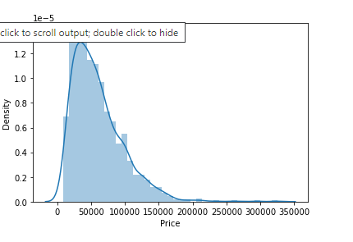
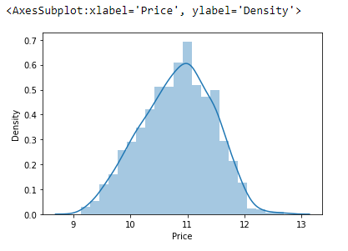
DISTRIBUTION CHECK
FIRSTLY DATA WAS NOT NORMAL BUT THAN WE PUT LOG TO MAKE IT NORMAL
NORMAL DATA IS MADNATORY FOR THESE TYPE PROBLEM

Slide 11
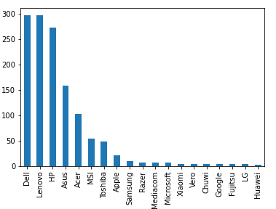
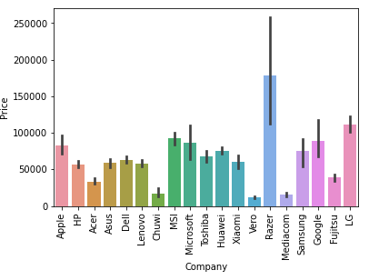
MARKET SHARE OF COMPANY
AS YOU SEE DEMAND OF DELL IS HIGH IN MARKET BUT ACCORDING TO PRICE MAJOR PORTION WAS COVERD BY RAZER .

Slide 12
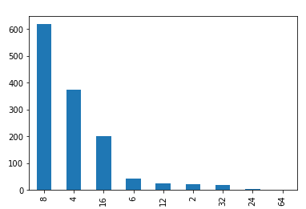
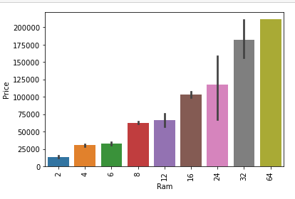
RAM WISE DEMAND
AS WE SEE IN FIRST GRAPH DEMAND FOR 8GB RAM IS HIGH AND IN SECOND GRAPH PRICE OF THE RAM DEPENDS ON SIZE OF THE RAM BOTH WILL SYMULTANIOUSLY INCREASE

Slide 13
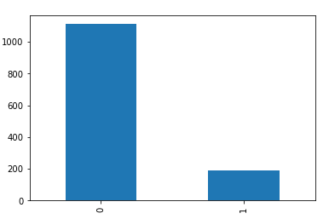
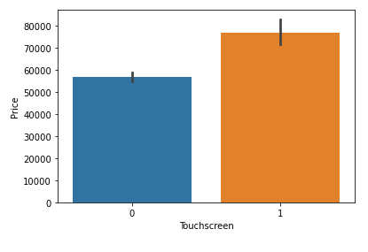

Slide 14
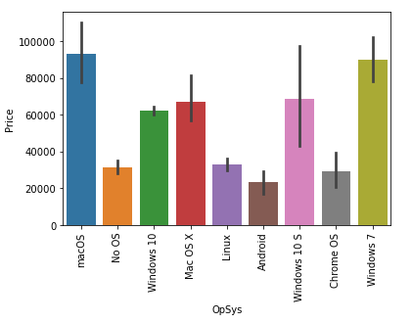
OPERATING SYSTEM
SEVERAL OPERATING SYSTEM ARE AVAILABLE IN MARKET BUT THE AVERAGE DEMAND OF WINDOWS ARE IMPRESIVE .IF WE COMPARE PRICE WISE SO MARKET WAS COVERD BY MAC-OS

Slide 15
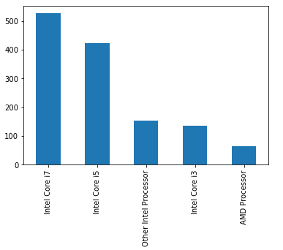
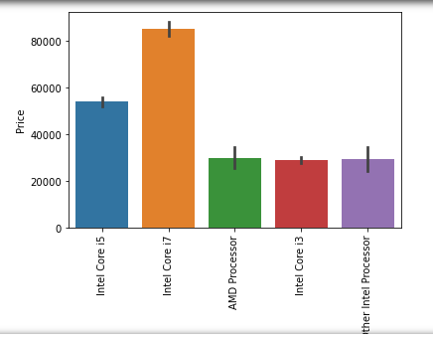
DEMAND FOR INTEL CORE 7 IS HIGH SIMULTANIOUSLY IT ALSO INCREASE THE PRICE.

Slide 16
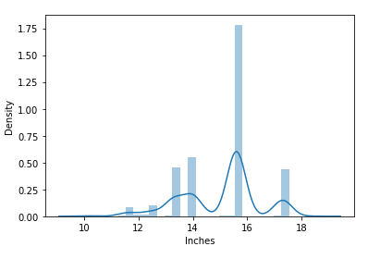
LENGTH OF THE LAPTOP
AS WE SEE FOCUSING AREA IS 15 -17 INCHES .THIS OBSERVATION HELP TO KNOW THE DEMAND OF THE MARKET ALSO HELP IN INVENTORY MANAGEMENT

Slide 17
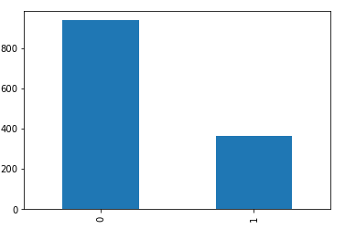
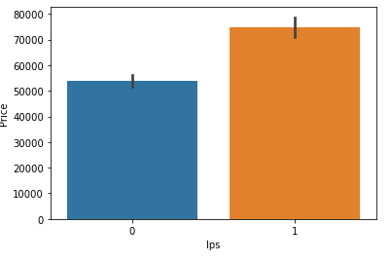
TECHNOLODGY WISE DEMAND

Slide 18
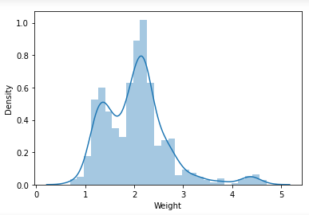
MAJORITY WEIGHT SIZE
AVRAGE WEIGHT OF THE LAPTOP IS SOMEWHERE AROUND BETWEEN 1KG TO 3KG
IT ALSO HINDER THE PRICE OF THE LAPTOP AND TECHNOLODGY .

Slide 19
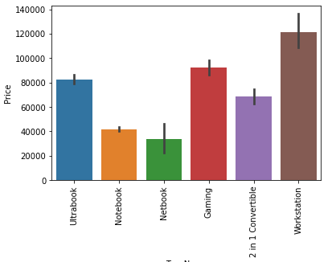
SPENDING OF MARKET
MAJORITY OF PEOPLE SPEND THEIR MONEY ON WORKSTATION AS THE PRICE INCRESE THE DEMAND OF UPGRADED TECHNOLODGY INCREASED

Slide 20
MODEL DEVELOPMENT

Slide 21
PRE – PROCESS TOOLS
Pipeline – IT’s sequence of data processing steps that are chained together to form a complete workflow.
OneHotEncoder – data transformation technique used in machine learning for encoding categorical features as numeric data that can be used as input to machine learning models.
ColumnTransformer - Used for applying different data transformations to different columns of a dataset.

Slide 22
Algorithm used
Linear Regression
Ridge
Lasso
Kneighbors Regressor
Decision Tree Regressor
Random Forest Regressor
GradientBoosting Regressor
Ada Boost Regressor
SVM
XGB Regressor

Slide 23
POST – PROCESS TOOLS
R2_score – IT’s a statistical measure used to evaluate the performance of a regression model. It represents the proportion of variance in the dependent variable that can be explained by the independent variables in the model.
Mean_absolute_error - is a common metric used to evaluate the performance of a regression model. It measures the average absolute difference between the actual values and the predicted values.

Slide 24
SUMMARY
In this project, we developed a machine learning model to predict the prices of laptops based on their specifications, such as the brand, screen size, processor, memory, and operating system. We used a dataset of over 1,300 laptops to train and test our model, and we used a combination of data preprocessing techniques and machine learning algorithms, including OneHotEncoder, ColumnTransformer, RandomForestRegressor, and GridSearchCV.
Our model achieved a high R2 score and a low mean absolute error, indicating that it was able to make accurate price predictions based on the given features. This project demonstrates the potential of machine learning for predicting prices of products and can be extended to other areas like real estate or stock prices.

Slide 25
NOW MOVE TO NOTEBOOK

